Slide 1
PPE and Burn Rate Calculator Review
Donna Ortelle, RN, MSN, Section Chief: Donna.Ortelle@ct.gov
Nick Peranzi, MBA, COVID-19 Commissioner’s Fellow: Nick.Peranzi@yale.edu
August 4, 2020

Slide 2
Agenda
LTC-MAP PPE reporting statistics
PPE Burn Rate Calculator usage review
Appendix
Optimizing supply of PPE and other equipment during shortages
PPE usage reminders

Slide 3
There are two primary concerns with the PPE data reporting in LTC-MAP
Half of facilities report inaccurate PPE counts
One third of facilities are not reporting daily usage
Based on 160 national guard visits to nursing homes in the two weeks ended July 27, 2020 Reports are considered accurate if variance from national guard count is less than 10% Facilities without same-day LTC-MAP reports excluded from chart
Based on LTC-MAP reports from nursing homes; data as of July 27, 2020
Accurate PPE reporting will allow us to better distribute to facilities in need and move into later reopening phases

Slide 4
Agenda
LTC-MAP PPE reporting statistics
PPE Burn Rate Calculator usage review
Appendix
Optimizing supply of PPE and other equipment during shortages
PPE usage reminders

Slide 5
PPE Burn Rate Calculator
Spreadsheet compatible with all major software programs
Microsoft Excel®
Google Sheets
OpenOffice
Available at CDC Website
https://www.cdc.gov/coronavirus/2019-ncov/hcp/ppe-strategy/burn-calculator.html

Slide 6
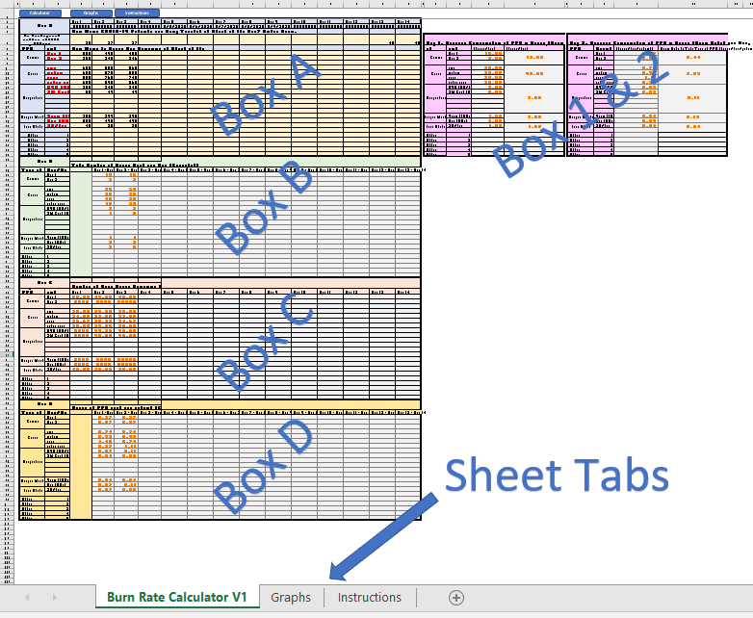
Spreadsheet sections
1 data entry area (Box A)
Enter one column of data per day
Two-weeks per file
5 data reporting areas
Do not alter Box B, C, D, 1 and 2
Graphing page
Provides visual summaries of data

Slide 7
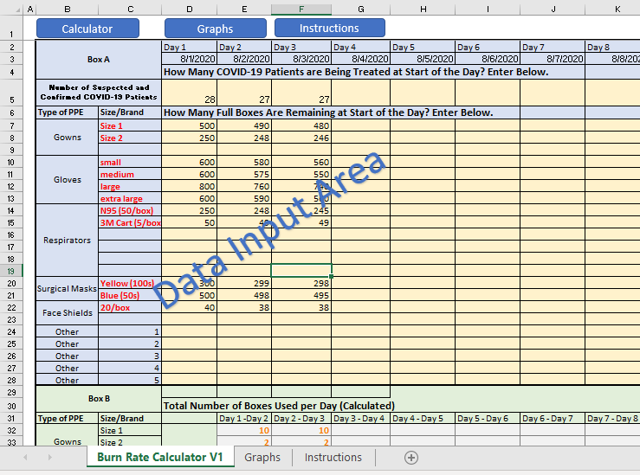
Burn rate calculator: Box A

Slide 8
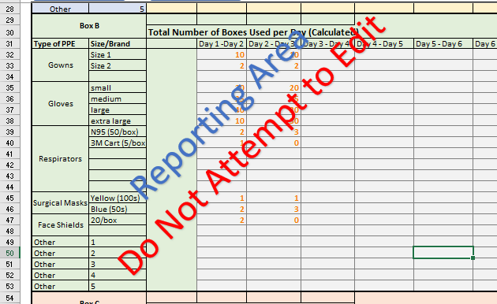
Burn rate calculator: Box B

Slide 9
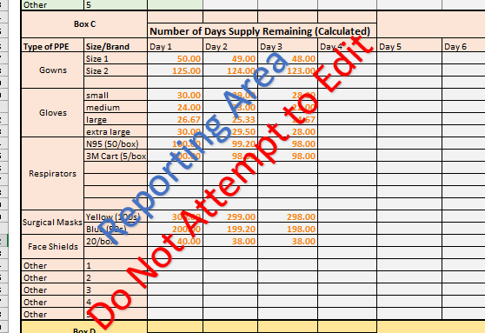
Burn rate calculator: Box C

Slide 10
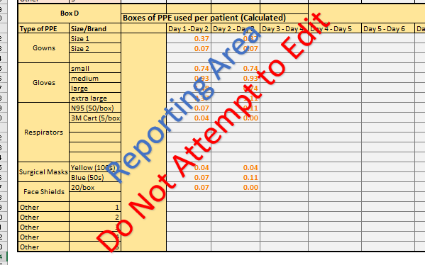
Burn rate calculator: Box D

Slide 11
Burn rate calculator: Report boxes 1 & 2

Slide 12
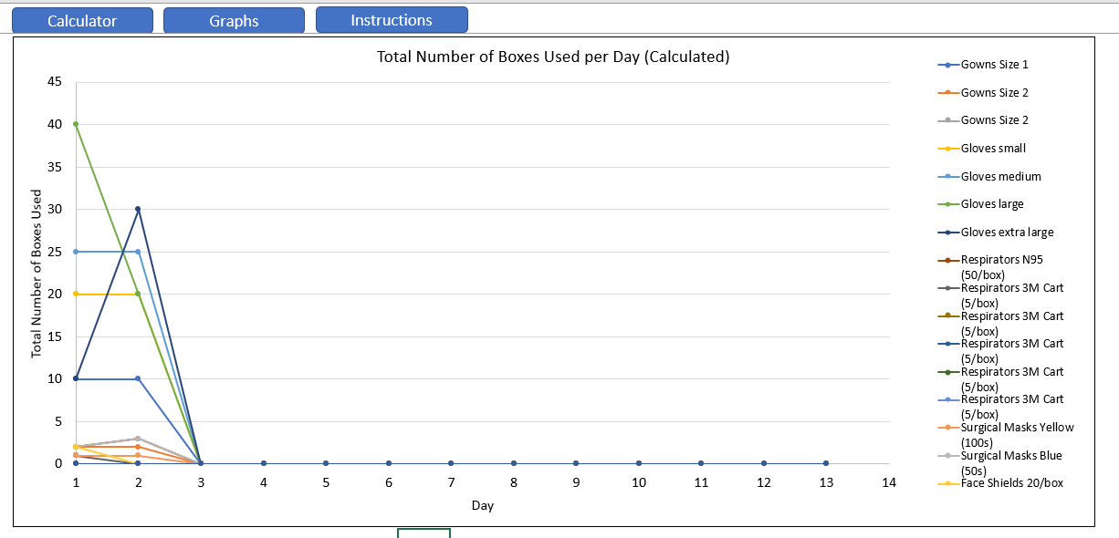
Graph reports: boxes used per day

Slide 13
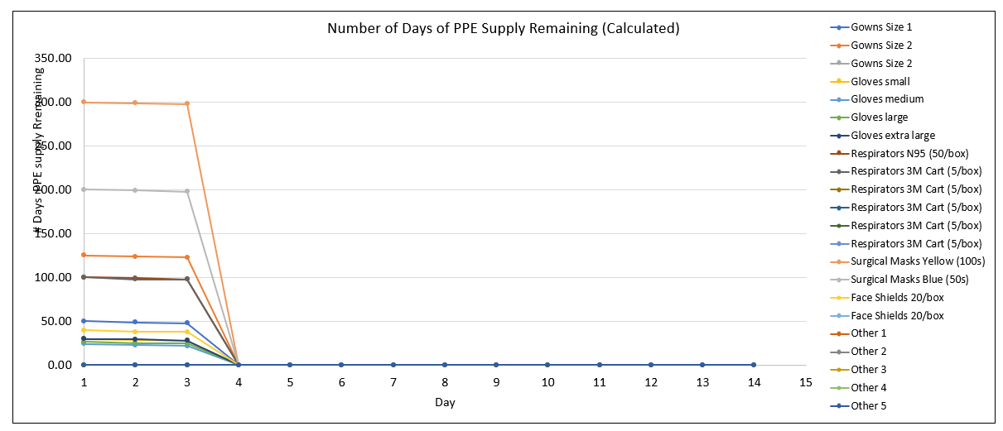
Graph reports: days of PPE supply remaining

Slide 14
Additional resources
Video training: https://youtu.be/E_mhrROqJh0
Also accessible from the CDC website

Slide 15
Questions

Slide 16
Appendix
Optimizing supply of PPE and other equipment during shortages
PPE usage reminders

Slide 17
Optimizing supply of PPE and other equipment during shortages​
https://www.cdc.gov/coronavirus/2019-ncov/hcp/ppe-strategy/index.html​

Slide 18
Shortage strategies: all types of PPE
Conventional | Contingency | Crisis
Use physical barriers and other engineering controls Limit number of patients going to hospital or outpatient settings Use telemedicine whenever possible Exclude all HCP not directly involved in patient care Limit face-to-face HCP encounters with patients Exclude visitors to patients with known or suspected COVID-19 Cohort patients and/or HCP | Selectively cancel elective and non-urgent procedures and appointments for which PPE is typically used by HCP Decrease length of hospital stay for medically stable patients with COVID-19 | Cancel all elective and non-urgent procedures and appointments for which PPE is typically used by HCP

Slide 19
Shortage strategies: N95 respirators
Conventional | Contingency | Crisis
Implement just-in-time fit testing Limit respirators during training Implement qualitative fit testing Use alternatives to N95 respirators such as other filtering facepiece respirators, elastomeric respirators, and powered air purifying respirators Additional guidance | Temporarily suspend annual fit testing Use N95 respirators beyond the manufacturer-designated shelf life for training and fit testing Extend the use of N95 respirators by wearing the same N95 for repeated close contact encounters with several different patients Additional guidance on contingency capacity strategies Additional guidance on extended use | Use respirators beyond the manufacturer designated shelf life for healthcare delivery Use respirators approved under standards used in other countries Implement limited re-use of N95 respirators. During times of crisis, it may be needed to practice limited re-use on top of extended use Use additional respirators beyond the manufacturer-designated shelf life that have not been evaluated by NIOSH Prioritize the use of N95 respirators and facemasks by activity Additional guidance on crisis capacity strategies Additional guidance on re-use

Slide 20
Shortage strategies: facemasks
Conventional | Contingency | Crisis
Use facemasks according to product labeling and local, state, and federal requirements Additional guidance | Place facemasks in a secure and monitored site Provide facemasks to symptomatic patients upon check-in at entry points Implement extended use of facemasks Restrict facemasks for use by HCP, rather than asymptomatic patients (who might use cloth face coverings) for source control Additional guidance | Use facemasks beyond the manufacturer-designated shelf life during patient care activities Implement limited re-use of facemasks Prioritize facemasks for selected activities such as essential surgeries, activities where splashes and sprays are anticipated, prolonged face-to-face contact with an infectious patient, and aerosol-generating procedures When no facemasks are available: Use a face shield that covers the entire front (that extends to the chin or below) and sides of the face with no facemask Additional guidance

Slide 21
Shortage strategies: gowns
Conventional | Contingency | Crisis
Use isolation gown alternatives that offer equivalent or higher protection Additional guidance | Shift gown use toward cloth isolation gowns Consider the use of coveralls Use gowns beyond the manufacturer-designated shelf life for training Use gowns or coveralls conforming to international standards Additional guidance | Extend the use of isolation gowns Re-use cloth isolation gowns Prioritize gowns for activities where splashes and sprays are anticipated and during high-contact patient care When no gowns are available: Consider using gown alternatives that have not been evaluated as effective Additional guidance

Slide 22
Shortage strategies: eye protection
Conventional | Contingency | Crisis
Use eye protection according to product labeling and local, state, and federal requirements Additional guidance | Shift eye protection supplies from disposable to re-usable devices Extend the use of eye protection Additional guidance | Use eye protection devices beyond the manufacturer-designated shelf life Prioritize eye protection for activities where splashes and sprays are anticipated, or where prolonged face-to-face or close contact is unavoidable Consider using safety glasses that cover the sides of eyes Additional guidance

Slide 23
Shortage strategies: gloves
Conventional | Contingency | Crisis
Continue providing patient care as in usual infection control practice Additional guidance | Use gloves past their manufacturer-designated shelf life for training activities Use gloves conforming to other U.S. and international standards Additional guidance | Use gloves past their manufacturer-designated shelf life for healthcare delivery Prioritize the use of non-sterile disposable gloves Consider non-healthcare glove alternatives Extend the use of disposable medical gloves Additional guidance

Slide 24
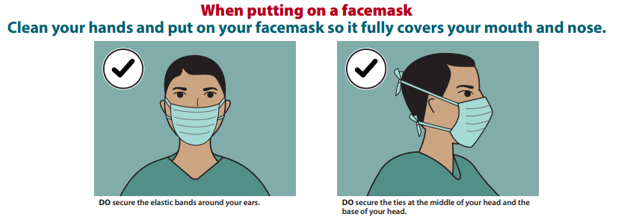
PPE usage reminders: facemask do’s and don’ts (1/3)

Slide 25
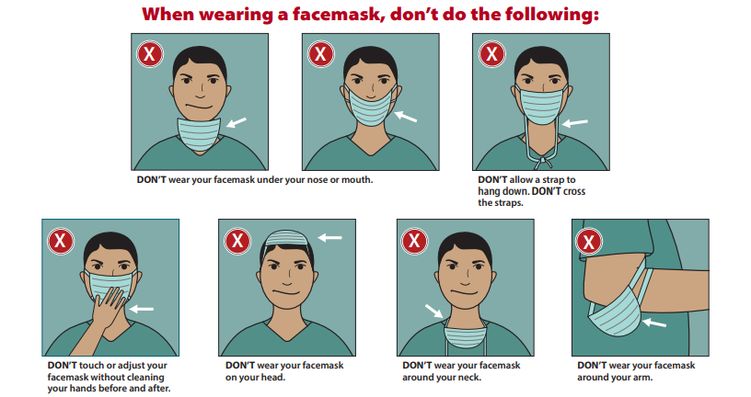
PPE usage reminders: facemask do’s and don’ts (2/3)

Slide 26
PPE usage reminders: facemask do’s and don’ts (3/3)
If implementing limited-reuse: Facemasks should be carefully folded so that the outer surface is held inward and against itself to reduce contact with the outer surface during storage. Folded facemasks can be stored between uses in a clean sealable paper bag or breathable container.

Slide 27
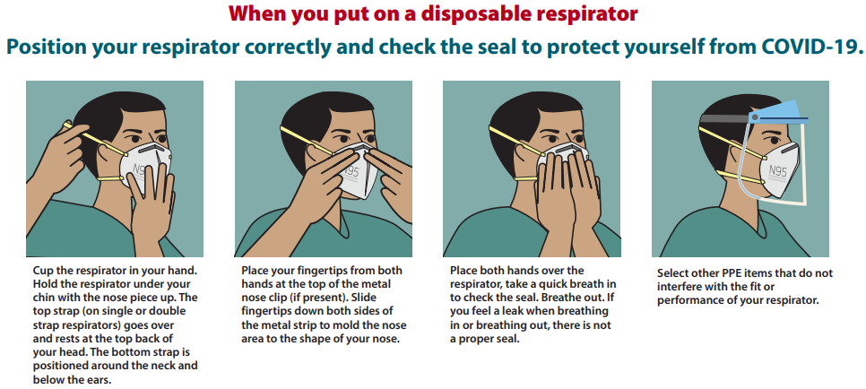
PPE usage reminders: respirator do’s

Slide 28
PPE usage reminders: respirator don’t’s

Slide 29
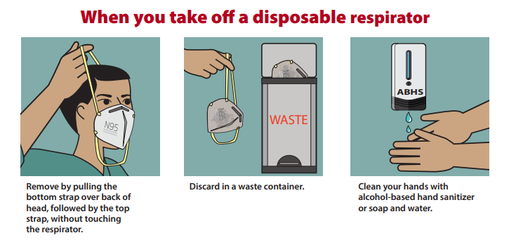
PPE usage reminders: removing a respirator
Facilities implementing reuse or extended use of PPE will need to adjust their donning and doffing procedures to accommodate those practices.​

